Slide 1

Top Computer Viruses: A Deep Dive
Join us for a journey into the captivating world of computer viruses, exploring their history, characteristics, and impact on our digital landscape.
Amir Mahdi Zare

Slide 2
Unveiling Computer Viruses
What is a Computer Virus?
Types of Viruses
A malicious program designed to spread from one computer to another. Viruses can disrupt computer operations, steal data, and cause significant damage.
There are various types of viruses, each with a different mode of operation. Examples include boot sector, file, macro, and script viruses.

Slide 3
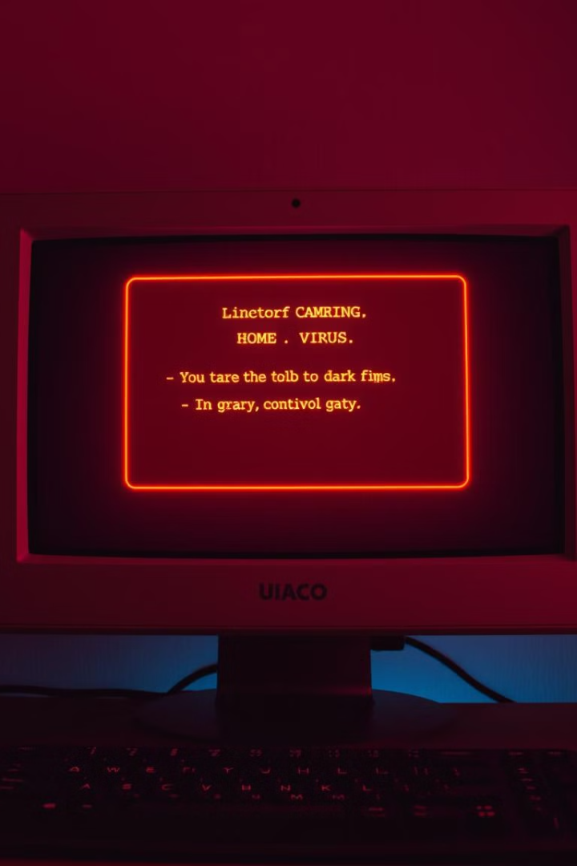
Traits of Successful Viruses
Stealth
Polymorphism
They can hide their presence and avoid detection by antivirus software.
They can change their form to evade detection, making it difficult to identify and eradicate them.
Persistence
Propagation
They can remain active on a computer for extended periods, even after an attempt to remove them.
They can spread to multiple computers easily through various methods, including email attachments, infected websites, and removable media.

Slide 4

Methods of Creation and Distribution
Code Manipulation
Social Engineering
Viruses are created by malicious code, often written in programming languages like C++, C#, or Assembly.
Spread through deceptive tactics, tricking users into clicking malicious links or opening infected files.
Exploiting Vulnerabilities
They take advantage of security flaws in operating systems, applications, or network protocols.

Slide 5

Notable Viruses of the Past
Creeper (1971)
I Love You (2000)
One of the first viruses, it replicated itself on the ARPANET, a precursor to the internet.
A widespread email worm that infected millions of computers worldwide, causing significant damage.
1
2
3
4
Brain (1986)
Conficker (2008)
An early boot sector virus that spread through floppy disks, affecting IBM-compatible PCs.
A highly complex worm that infected millions of computers, disabling network services and hindering security.

Slide 6
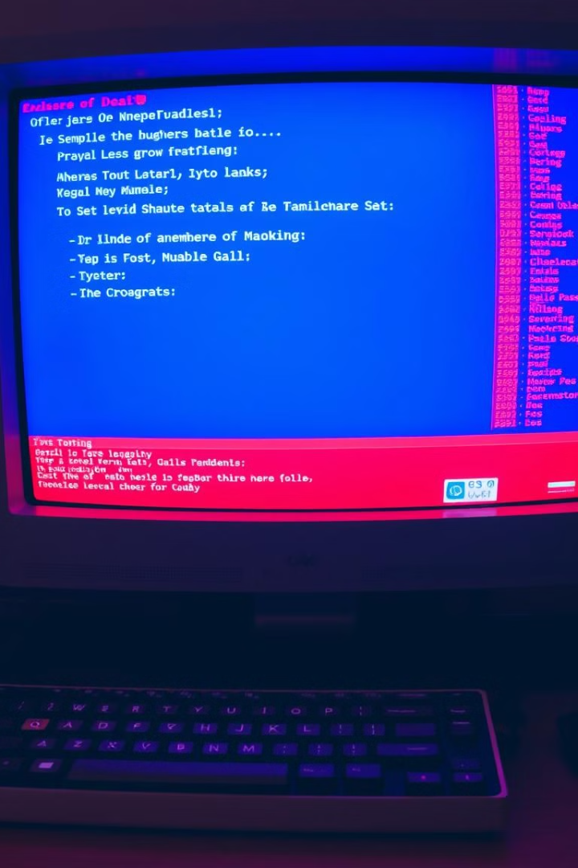



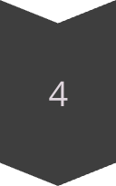
Impact on Computer Systems
Data Loss
Viruses can delete, encrypt, or corrupt data, leading to permanent loss of important files and information.
System Failure
They can crash computer systems, render them unusable, and require extensive repairs or reinstallations.
Security Breaches
They can steal sensitive information, including passwords, bank details, and personal data, compromising user privacy and security.
Performance Degradation
Viruses can slow down computer performance, affecting responsiveness, program execution, and overall system stability.

Slide 7
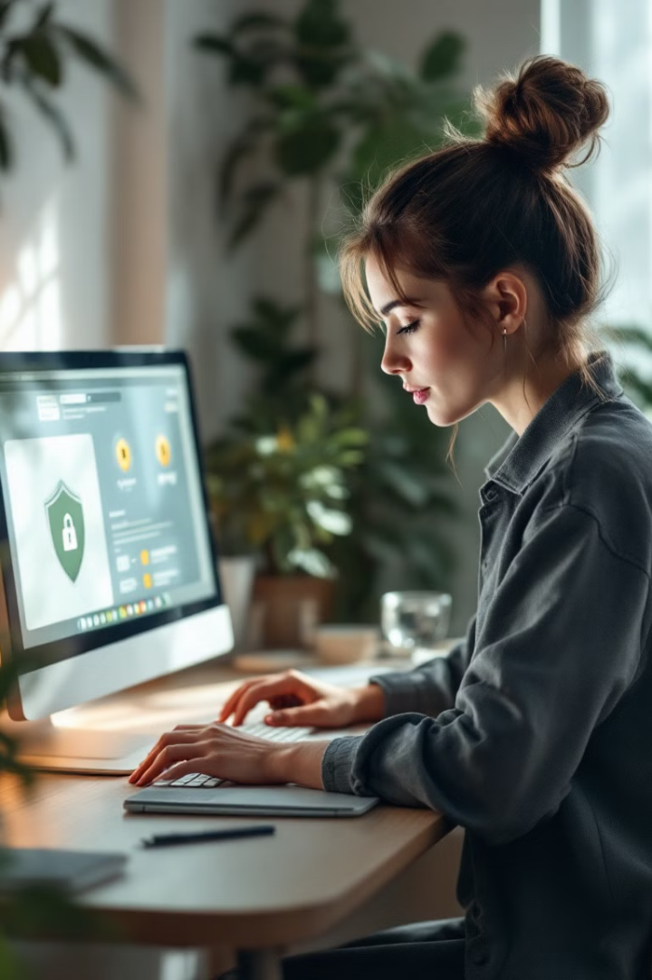




Combating Computer Viruses
Antivirus Software
Security Updates
Essential tools for detecting, removing, and preventing viruses from infecting computers.
Regularly updating operating systems, applications, and antivirus software is crucial for patching vulnerabilities.
Firewall
Safe Browsing Practices
Acts as a barrier between a computer and the internet, blocking unauthorized access and preventing malware from entering the system.
Being cautious about clicking links, opening attachments, and downloading files from unknown sources.

Slide 8



The Future of Computer Viruses
AI-powered Viruses
1
Viruses leveraging artificial intelligence to become more sophisticated, stealthy, and adaptable.
IoT Attacks
2
Viruses targeting Internet of Things devices, including smart homes, wearable technology, and industrial control systems.
Quantum Computing Threats
3
The emergence of quantum computers could lead to the development of new and powerful viruses that can bypass traditional security measures.

